Slide 1

Week 6
JINGYA LI

Slide 2
Outline
Background Input
Group Presentation
Reading Text A
Exercises

Slide 3
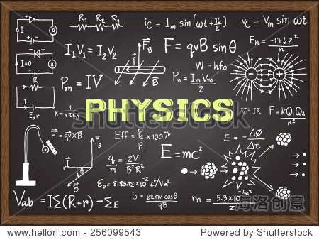

Physics

Slide 4
Physics
Definition (from Cambridge Dictionary):
The scientific study of matter and energy and the effect that each has on the other.
To raise new questions, new possibilities, to regard old problems from a new angle, requires creative imagination and marks real advance in science.
--Albert Einstein

Slide 5
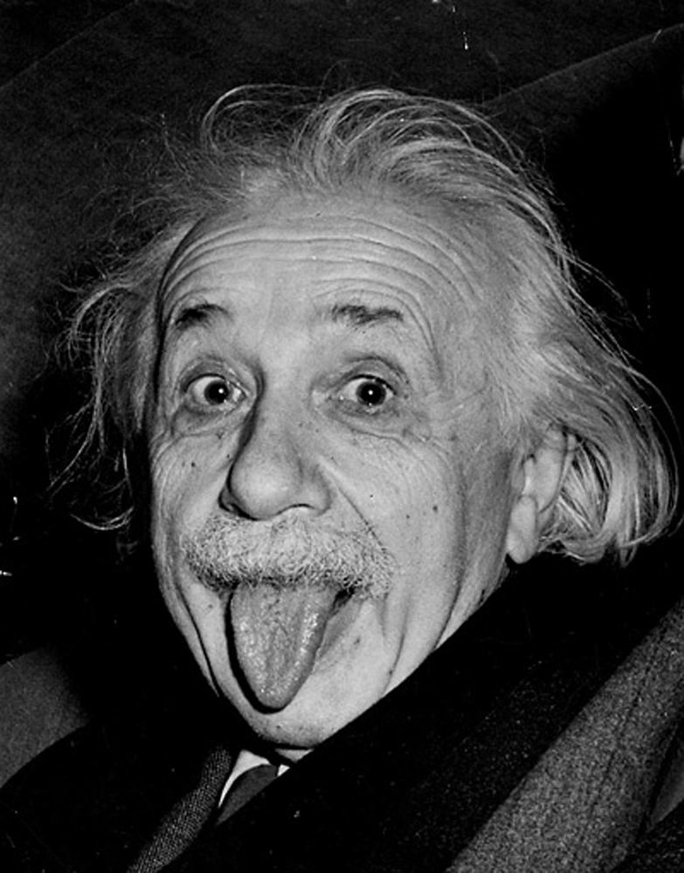
Why do you think Einstein can succeed?
Group discussion
His success came from questioning conventional wisdom and marveling at mysteries that struck others as mundane.
This led him to embrace a morality and politics based on respect for free minds, free spirits, and free individuals.

Slide 6
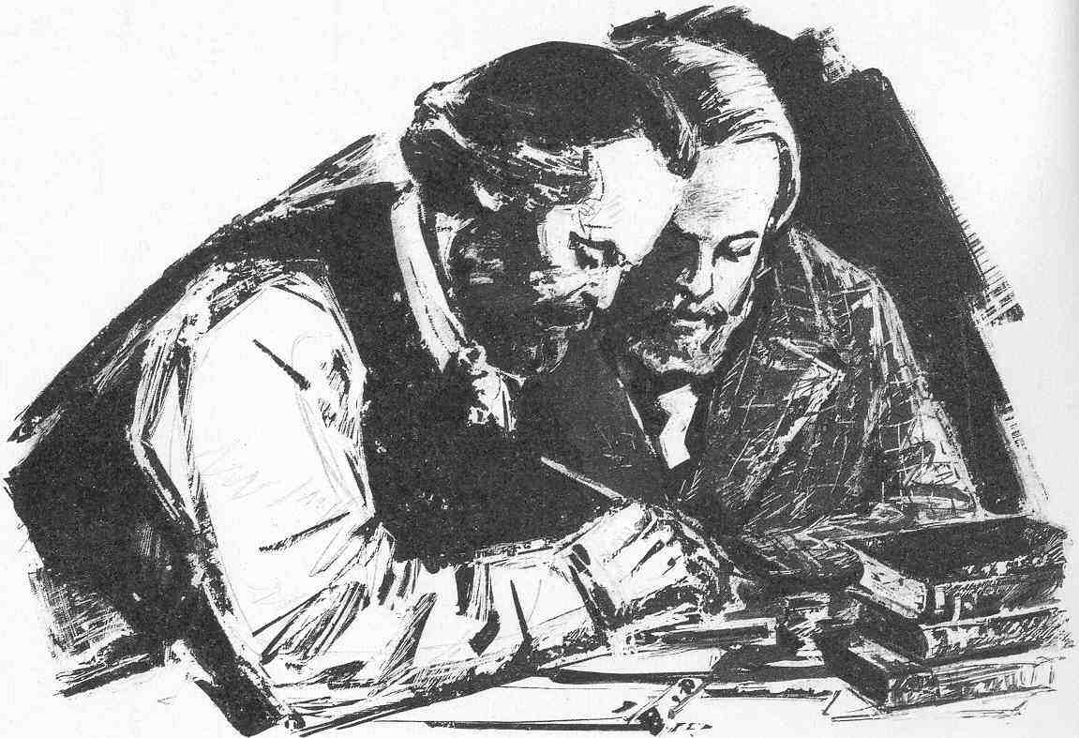
Theorist
Someone who develops ideas about the explanation for events (Cambridge Dictionary).
Theorists observe various phenomena and use reasoning to come up with practical ideas that should be proven.
The most famous theorist was albert Einstein who gave the theory of relativity.

Slide 7

Experimentalist
A person conducting scientific experiments.
Experiment is to test theories and to provide the basis for scientific knowledge.
Experiment can call for a new theory, either by showing that an accepted theory is incorrect, or by exhibiting a new phenomenon that is in need of explanation.

Slide 8

Group Presentation

Slide 9
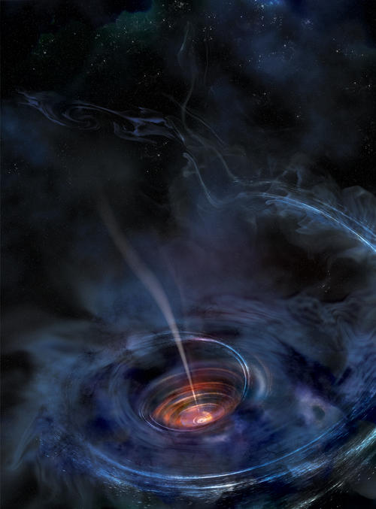
The bending of starlight by the gravitational field
Gravitational field
Used to explain the force or influence that a massive body, like an excessive star, extends into the space.
Einstein’s theory on gravitational field
It predicts that light is bent when it passes close to a massive body.
Sir Arthur Eddington verified this prediction
When he observed the bending of starlight by the Sun during a solar eclipse in 1919

Slide 10
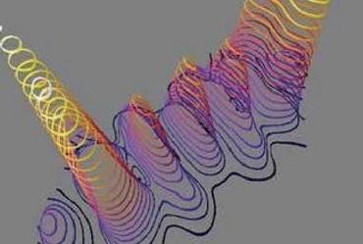
The theory of Quantum Electrodynamics (QED)
QED is a branch in particle physics.
Particle physics:
the study of the particles that make up atoms and the way they behave and react.
The theory of QED describes how light and matter interact.
It is the first theory to achieve a full agreement between quantum mechanics and special relativity.

Slide 11
Theme of Text A
This article
explains the importance of experimentalists’ work,
illustrates two reasons why the public holds different appreciation of theorists and experimentalists,
calls for experimentalists to work with journalists to gain public recognition.

Slide 12
Organization of Text A
Section 1 (Paras. 1-8):
Even thought physicists understand the significance of experimentalists, the public still holds different appreciation of theorists vs. experimentalists.
Section 2 (Paras. 9-14):
There are two reasons to explain why the public “fails to give experimentalists their due”.
Reason 1: There is the absolute success of theoretical physics, which is often the precedent of experimental discoveries.
Reason 2: The public has different visibility of theoretical physics and experimental physics.
Section 3: (Paras. 15-16)
Experimentalists and their journalist friends should work together to help the public recognize the value of experiments.

Slide 13
Translation practice
Group work (10 mins)
Each group prepares four translations.

Slide 14
Key Sentences
Without the 1968 experiments of Kendall, Friedman and Taylor at the Stanford Linear Accelerator Center (SLAC), quarks would have remained a mere theory, a will-o-wisp whose existence was confidently postulated but never proven.
如果没有1968年科德尔、弗里德曼和泰勒在斯坦福直线加速器中心 (SLAC) 所做的实验，夸克将仅仅是一种理论，一种未经证实的、飘渺的大胆假设。

Slide 15
Key Sentences
People similarly know about Wolfgang Pauli and Enrico Fermi stating the requirement for a ghostly particle called the neutrino in the 30s, but ask popular science enthusiasts if they are aware of the dogged pursuit of the neutrino by Raymond Davis for over 30 years and you will likely see knitted brows.
同样，人们熟悉在30年代提出了幽灵粒子（即中微子）条件的泡利和费米，但如果你询问科普爱好者们是否了解戴维斯在30余年间，一直不懈的捕捉中微子的踪迹，你很可能发现他们眉头紧锁。

Slide 16
Key Sentences
This gap in perception is especially startling, given the singular importance of experiment in physics and all of science, a central paradigm that has been the centerpiece of the scientific method since Galileo (apocryphally) dropped iron balls from the leaning tower of Pisa.
考虑到实验在物理学和所有学科领域中的重要性，这种感知上的差距尤其令人吃惊，自伽利略（据传言）从比萨斜塔扔下铁球以来，实验作为一种非常重要的范式就成为核心的科学方法。

Slide 17
Key Sentences
It seems to me that there are at least two important reasons why the public, in spite of tacitly appreciating the all-important role of experiment in physics, fails to give experimentalists their due.
在我看来，至少有两个重要的原因可以解释为什么尽管公众默认实验在物理学中有至关重要的作用，却没有给实验物理学家应有的地位。

Slide 18
Key Sentences
Nobody can fail to gasp in awe at an Einstein or Bohr who, working with a few facts and pencil and paper, divine grand operating principles for the cosmos in short order.
无人不深深崇敬爱因斯坦或波尔等科学家，他们仅依据一些事实，靠着纸笔，便在短时间内推测出宇宙宏伟的运行规律。

Slide 19
Key Sentences
To be fair though, it’s hard not to admire theorists when many experimentalists as ingenious as their contraptions are, “simply” validate things which the theorists have already said.
不过，公平的说，我们很难不崇拜理论物理学家，因为虽然很多实验物理学家像他们的装置一样富有创意，但也“仅仅”是验证了物理学家早已说过的东西。

Slide 20
Key Sentences
Firstly, however, it’s very important to realize that all the awe for Einstein which we rightly feel comes only after the fact, after a thousand increasingly demanding tests of general relativity have established the veracity of the theory beyond any doubts.
但重要的是，我们首先要认识到，我们对爱因斯坦的所有崇敬之情都来自于广义相对论在经过千百次日益严格的测试才被证实这一事实之后。

Slide 21
Key Sentences
Experimentalists often follow in the steps of theorists, but the instances in which they lead the way are as full of creativity and achievement as the work of an Einstein, Bohr or Feynman.
实验物理学家经常跟随理论物理学家的脚步，而有时他们也会引领理论物理学家，其过程就像爱因斯坦、波尔或费曼等科学家的工作一样充满了创造力，成就非凡。

Slide 22
Key Sentences
In addition, the manipulation of these tools to plumb the depth of nature’s secrets is every bit as exciting to its practitioners as calculating the curvature of space-time is (exciting) to its own.
此外，巧用这些工具探究自然的奥秘，对实验物理学家来说，就像计算时空曲率对理论物理学家一样令人兴奋。

Slide 23
Let’s do an experiment!
Discussion question
What is the theory of the experiment?
Which part of the experiment proves the theory?

